Slide 1
PMP® Exam Preparation PMP 250 Session # 2 Introduction to: Project Management, Project Environment & Project Managers’ Role
Project Management Professional, (PMP), is a registered mark of the Project Management Institute , Inc.

Slide 2
The contents of this lesson are based on:
A Guide to Project Management Body of Knowledge (PMBOK® Guide) Sixth Edition
Published and Owned by
Project Management Institute, PMI®
PMBOK, PMP, CAPM and PMI are registered trade marks of Project Management Institute, Inc.

Slide 3
Learning Objectives
Understand:
Projects, Programs, Portfolios
Project Management
Key Terms
Project Management Context
The Environment In Which Projects Operate
Project Management Processes
How They Interact

Slide 4
Overview
Project Management Institute (PMI)®
Project Management Body of Knowledge (PMBOK)
PMI describes PMBOK as an inclusive term that describes the knowledge within the profession of project management that includes:
proven, traditional practices that are widely applied
innovative practices that are emerging in the profession.

Slide 5
Overview
A Guide to the Project Management Body of Knowledge PMBOK® identifies a subset of project management body of knowledge which:
Are generally recognized good practice
Are applicable to most projects most of the time
Provides a common vocabulary
Provides a foundation upon which organizations can build methodologies, policies, procedures, rules, and techniques and life cycle phases needed to practice project management
Is used by PMI® as a standard to provide a consistent structure for its professional development programs
But it does not mean that they are or should be applied uniformly on all projects.

Slide 6
“Must Knows”
The Project Management, Project & Product Life Cycles
Characteristics of a Projects and a Subproject
Characteristics of Programs and Program Management
Characteristics of Portfolios and Portfolio Management
The Relationship between project management, operations management, program and portfolio management
Characteristics and purpose of Strategic Planning
Characteristics and Benefits of PMO
The Triple Constraint and how it functions
Aligning Plan-Do-Check-Act with the Project Management Life Cycle

Slide 7
“Must Knows” (cont.)
The responsibility of and difference between a Project Coordinator and Project Expeditor
Phase-to-phase Relationships and when to use Sequential and Overlapping Phases
Differences and Characteristics of the Various Personnel involved in Project Management
Influences of Organizational Structure on Projects (PMBOK® Guide 6th Edition Table 2-1)

Slide 8
Project Management
Project Management
Project
Management
Introduction
The Environment
In Which Projects
Operate
The Role of the
Project Manager
Introduction

Slide 9
About Projects
Projects come in many different sizes and are found in both business and industrial environments, including:
Construction and infrastructure engineering
Defense and aerospace
Public sector facilities and services
Research and development
High-tech, computer and communications
General manufacturing plants
Finance, insurance, tourism, arts, etc.
Introduction

Slide 10
About Projects
Projects have been in existence for a long time
Examples of projects:
Pyramids of Egypt, Great Wall of China, Taj Mahal, Panama Canal
Olympic Games
Humans Landing on the moon
Commercial Software Applications
Portable GPS Devices
Space Station in Earth’s Orbit
Introduction

Slide 11
About Projects
Most projects require a combination of organizational resources, assembled together to create something unique that will contribute to the development and execution of organizational strategy; for example:
A new or unique product,
A new service or a capability
Improvements to existing products or services
A result; i.e., a document or a process.
Introduction

Slide 12
What Is a Project? (**important for exam)
“A project is a temporary endeavor undertaken to create a unique product, service or result”
temporary endeavor means every project has a definite beginning and a definite end. A project ends when:
The project’s objectives have been achieved, or cannot be achieved
Funding is exhausted or resources no longer are available
The need for the project no longer exists, or the project is terminated for convenience or legal cause.
** start and end date are planned before project starts
unique means that the product or service differs in some distinguishing way from all similar products or services (not been done before), although there might be some repetitive deliverables or activities in the project.
Introduction

Slide 13
What Is a Project?
Projects are
Performed by people
Constrained by limited resources and time
Planned, executed and controlled
Projects
Come in different sizes
Have a life cycle (begin, peak, decline, end)
Often interact with other projects
Live in a world of conflicts
Often implemented as a means of achieving an organizations strategic plan
Drive change in organizations
Enable business value creation; i.e., quantifiable tangible and/or intangible benefits, such as monetary assets, or goodwill.
Introduction

Slide 14
Project Initiation Context Categories of 4 Factors leading to project initiation (For detail examples, see PMBOK® 6th Edition, Chapter 1, Table 1.1)
Project
Meet Regulatory, Legal or Social Requirements
Satisfy Stakeholder Requests or needs
Create, Improve or Fix Products, Processes, or Services
Implement or Change Business or Technological Strategies

Slide 15
What Is Project Management?
Project management is the application of knowledge, skills, tools, and techniques to project activities to meet project requirements.
It is accomplished through the application and integration of processes identified for executing projects effectively and efficiently.
Introduction

Slide 16
What Is Project Management?
It is the art of directing and coordinating human and material resources throughout the life of a project to achieve project objectives within specified constraints.
Balancing competing demands among:
Scope, time, cost, risk and quality
Stakeholders with different needs and expectations
Identified requirements (needs) and
Unidentified requirements (expectations, often not pay-for)
Setting up, maintaining and actively carrying out effective and collaborative communications
Note: Many of the processes are iterative in nature due to the existence of progressive elaboration throughout the project lifecycle

Slide 17
Why Project Management?
Deploying Effective & Efficient Project Management competency, enables an organization to:
Accomplish business goals through project results.
Achieve greater market competitiveness
Sustain the organization, through business environment changes.
Adjust plans to respond to the impact of such changes.
Introduction

Slide 18
Advantages of Using Formal Project Management
Better control of financial, physical, and human resources
Improved customer relations
Shorter development times
Lower costs
Higher quality and increased reliability
Higher profit margins
Improved productivity
Better internal coordination
Higher worker morale

Slide 19
Project Management Overview
A Guide to the
Project Management
Body of Knowledge
(PMBOK® Guide)- Sixth
Edition, Project
Management Institute Inc.,
Organizational behavior,
financial forecasting,
planning
Generally Accepted
Project Management
Knowledge and
Practice
Technical elements,
Management elements,
Industry groups
General Management
Knowledge and
Practice
Application Area
Knowledge and
Practice
Operations
of an ongoing
enterprise

Slide 20
Market’s View of Project Management
Usage/Effort
Within
Budget ?
On
Schedule?
Time
Cost
Project
Management
Processes
Viability
Competitiveness
Scope
Quality
Is Every
Expected
Function/Feature
Completed?
Conforms
to Specs?
Performance

Slide 21
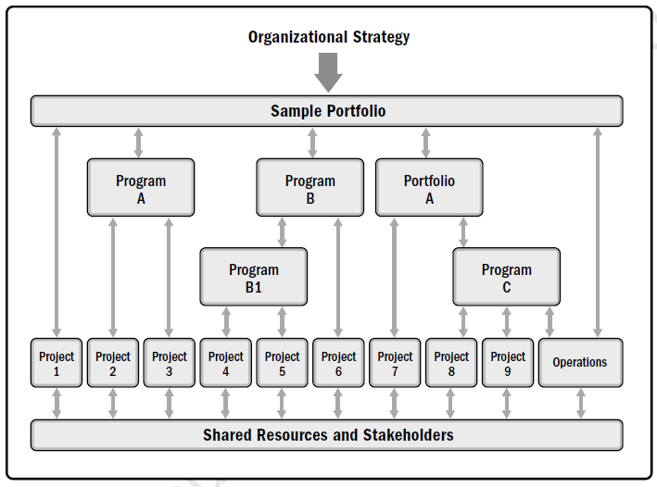
RELATIONSHIP OF PROJECT, PROGRAM, PORTFOLIO, AND OPERATIONS MANAGEMENT
For Comparative overview of Portfolios, Programs, and Projects
See PMBOK® 6th Edition, Chapter 1, Table 1.2

Slide 22
Other Key Terms - Programs
A Program is a group of related projects, sub-programs, and program activities managed in a coordinated way to obtain benefits not available from managing them individually.
Program Management is the application of knowledge, skills and principles to a program in order to meet the program requirements and to obtain benefits and control not available by managing projects individually.
Program Management focusses on the project - program interdependencies in terms of:
Aligning with organizational or strategic direction
Allocating the program scope into program projects
Resolving constraints and conflicts affecting projects within the program
Managing change requests
Allocating budgets across multiple projects within the program
Assuring realization of benefits from the projects within the program.

Slide 23
Other Key Terms - Portfolios
Portfolio: A collection of, not necessarily related projects, programs and operations managed as a group to achieve strategic business objectives.
Portfolio Management involves the centralized management of one or several portfolios to achieve strategic business goals, through prioritization of resource allocations for the constituent projects, programs and operations, and aligning these with organizational strategies. The aim of portfolio management is:
Guide investment decisions, and achieve desired ROI
Select optimum mix of programs and projects to meet strategic objectives
Prioritize resource allocation
Centralize the management of aggregate risk profile of all components

Slide 24
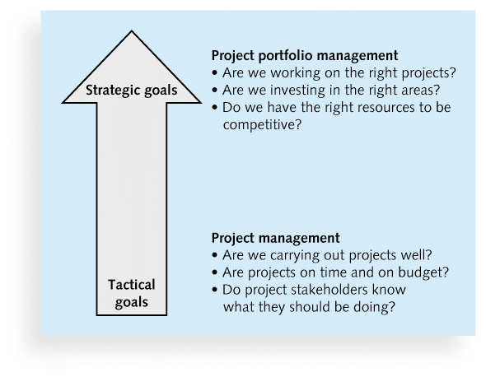
Project Management Compared to Project Portfolio Management

Slide 25
Other Key Terms – Operation Management – (manage by portfolio managers)
Operation Management, (OM): is the application of knowledge, skills and principles to ongoing production of goods and services, to ensure that the business operations are performed efficiently, by deploying the optimal resources needed to meet customer requirements. OM is an area of decision sciences that falls outside the project management discipline. The common areas between OM and project management occur at various points during the product life cycle, such as:
Developing a new product, or upgrading an existing product
Improving operations or product development process
At the end of the product life cycle
At each closeout phase.
Deliverables and knowledge are transferred from the project to operations for utilization of the delivered work.

Slide 26
Other Key Terms – Organizational Project Mgmt. & Strategies (OPM)
OPM is the framework in which Portfolio, Program and project management are integrated with organizational enablers to achieve strategic objectives.
Within Portfolios and Programs, Projects are the means of achieving organizational goals and objectives.

Slide 27
PROJECT LIFE CYCLE
Phase gate: check points

Slide 28
Project & Development Life Cycles
Project Life Cycle: The series of phases that a project passes through from its start to completion. Project Life Cycles can be predictive (done before, following the same pattern) or adaptive (involve unknown parameters, need to learn and develop methodology)
Generally one or more phases within the project life cycle, are associated with the development of a product or a service – these are called, Development Life Cycle (developing a product or service)
Development Life Cycles, can be:
Predictive, (Waterfall): The project Scope, time and Cost are determined in the early phases. Scope changes are carefully managed.
Iterative: Scope is generally determined in the early phases. Time and cost estimates are routinely updated as the team’s understanding of the product increases, through the successive iterations (repeated cycles) that develop the product.
Incremental: The deliverable is created through a series of iterations that successfully add functionality within a predetermined time frame. The deliverable is completed after the final iteration.
Adaptive: A change-driven life cycle which is agile, iterative or incremental. The detailed Scope is defined and approved before the start of an iteration.
Hybrid: Combination of adaptive and predictive life cycle. The well known elements of the project follow a predictive development life cycle. The evolving elements follow an adaptive production life cycle.

Slide 29
Project Management Processes
A series Project Management activities, known as processes, are executed to produce one or more outputs from one or more inputs by using proper appropriate project management tools and techniques.
Processes are logically liked by the outputs they produce. An output of a process generally results in either, an input to another process, or a deliverable of the project or phase.
Inputs
(documents that
Will be acted upon)
Project Scope
Statement
Requirements
documentation
Organizational
Process Assets
Tools and
Techniques
(Mechanisms
applied to the
Inputs to create
the outputs)
Decomposition
Outputs
(Documents that
are the result
of the process)
Work Breakdown
Structure (WBS)
WBS Dictionary
Scope Baseline
Project document
updates
Context

Slide 30
Project Management Process Categories
Processes used once or at predetermined points in the project; example: Develop Project Charter, Scope Baseline.
Processes that are performed periodically or as needed; example: Acquire Resources, is performed as needed. Conduct Procurements is performed prior to needing procured items.
Processes that are performed continuously throughout the project; example: Define Activities may occur throughout the project. Many of the Monitoring and Control processes occur continuously.

Slide 31
Process Groups
Project Management Process Groups are logical groupings of processes linked by the results they produce - the result or outcome of one becomes an input to another.
Initiating
Processes
Planning
Processes
Controlling
Processes
Executing
Processes
Closing
Processes
Adopted from PMI’s PMBOK® Guide

Slide 32
Process Group Interaction
Project management process groups are overlapping activities which occur at varying levels of intensity throughout each phase of the project.
Executing
Processes
Level
of Inter-action
Planning
Processes
Closing
Processes
Initiating
processes
Controlling Processes
Phase
Start
TIME
Phase
Finish
Adopted from PMI’s PMBOK® Guide

Slide 33
Process Groups
Initiating Defining and Authorizing the project or a phase
Planning Establish the project scope, refines objectives and define the best course of action to attain them
Executing Processes performed to complete the work defined in the project management plan, to satisfy project requirements.
Monitoring Processes required to track, review and regulate performance & Controlling
Closing Formalizing acceptance and bringing the project or phase to an orderly end

Slide 34
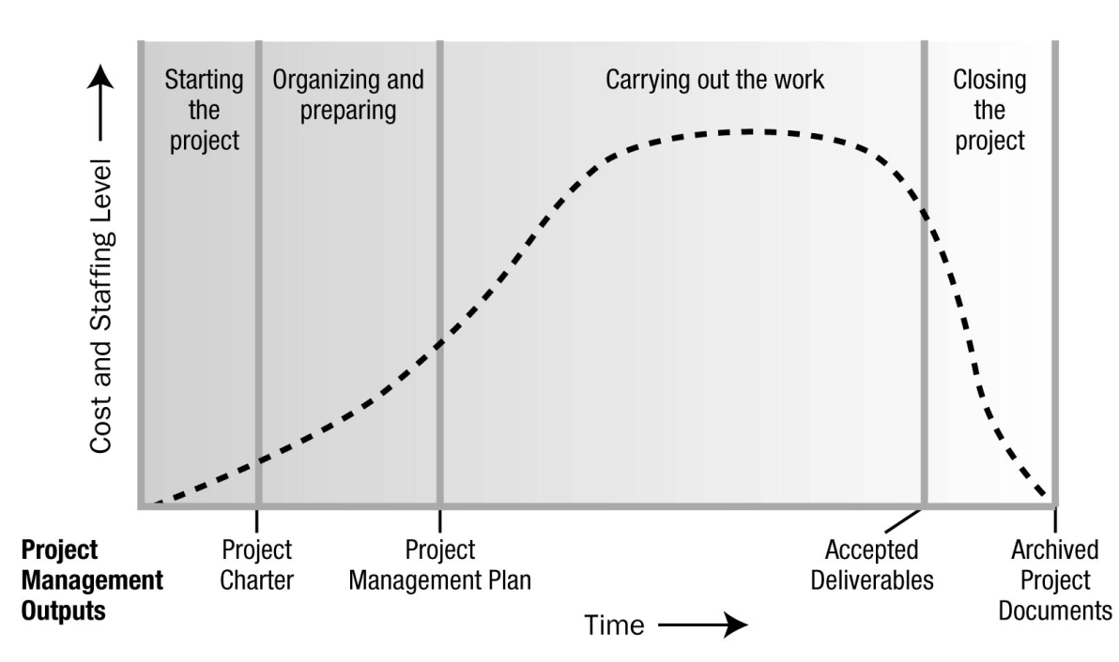
Cost & Staffing Levels Across Project’s Life Cycle

Slide 35
Project Life Cycle
Corporate Business Life Cycle
Policy
Planning
Identify
Needs
Project
Conception
Realization
Product in service
Disposal
Product Life Cycle
Feasibility
Acquisition
Operation
Disposal
Project Life Cycle
Concept
Development
Execution
Finish
Project life cycle is within a product life cycle, a product life cycle is within a corporate business life cycle

Slide 36
Project Life Cycle
Characteristics of a project life cycle
Uncertainty (Risk)
High
Low
Probability of Success
Concept
Develop
Execute
Finish
Time
Adopted from PMI’s PMBOK® Guide

Slide 37
Project Life Cycle
Characteristics of a project life cycle
High
Ability to add value
Low
Cost of Changes
Concept
Develop
Execute
Finish
Time

Slide 38
Project Management Knowledge Areas see PMBOK® 6th Edition Table 1-4
Integration Putting it all together
Scope: What needs to be done
Quality: To what standards
Time: Required effort/duration & sequential order of tasks
Cost: How much the tasks/project will cost
Risk: What is the degree of uncertainty
Resources: What human and non-human resources are needed
Procurement: What goods or services are required
Communications: How do all these people communicate.
Stakeholders Who impacts or is impacted by the project

Slide 39
Project Management Data & Information

Slide 40
Project Management Business Documents
Project Business Case
A documented feasibility study used to establish the validity of project benefits, used as a basis for the authorization of further activities to undertake the project.
Project Benefits Management Plan
A documented explanation defining the processes for creating, maximizing and sustaining the benefits provided by the project
PMBOK® 6th Edition, Table 1-5

Slide 41
Interrelationship of Needs Assessment and Critical Business/Project Documents
PMBOK® 6th Edition, Fig 1-8

Slide 44
Project Charter
A document issued by the Project Sponsor, to:
Project Management Plan
A document that describes how the project will be executed, monitored and controlled
Formally authorize the existence of a project
Designate a Project Manager
Authorize the project manager to apply organizational resources to project activities

Slide 45
Project Success
Traditional Metrics
Time, Cost, Scope, Quality
Stakeholders & PM Agreement on:
- How is success defined?
- How is success measured?
- What factors impact success?
Business Strategic Results
- Completing Business Benefits Plan
- Financial Targets: NPV, ROI, IRR, PBP, BCR
- Achieving Stakeholders Satisfaction
- Integrating deliverables into Org. environment
- Acceptable customer/end-user adoption

Slide 46
The Environment in Which Projects Operate
PMBOK® 6th Edition Chapter 2

Slide 47
Overview
Projects operate in environments that may have a favorable or unfavorable impact on them

Slide 48
ENTERPRISE ENVIRONMENTAL FACTORS (EEF)
Conditions NOT under the control of the project team, that influence, constrain, or direct the project
These conditions could be INTERNAL and/or EXTERNAL to the organization, and are considered as inputs to many planning processes.
INTERNAL
EXTERNAL
Organizational Culture, Structure and Governance
Geographic Distribution of Facilities and Resources
Infrastructure
Information Technology Software
Resource Availability
Employee Capability
Marketplace Conditions
Social and Cultural Influences and Issues such as politics
Legal Restrictions and laws
Commercial Databases
Academic Research
Government or Industry Standards
Physical Environmental Elements such as weather

Slide 49
ORGANIZATIONAL PROCESS ASSETS (OPA)
Process Assets that are controllable by the project team, that influence the management of the project; e.g., processes, policies, knowledge, practice, artifact, lessons learned from previous projects and historical data such as: completed schedules, Earned Value, costs, etc.
OPAs are inputs to many project management processes, and are updated or added to as applicable throughout the project.
Processes, Policies, Procedures
Processes, Policies, Procedures
Initiating & Planning
Guidelines for adopting standard processes to project needs
Specific org. standards & policies
Product & project methods, procedures and life cycles
Templates, documents, registers, report formats, definitions, risk matrices, etc.
Pre-approved supplier lists, and various types of contractual agreements.
2. Executing, Monitoring, Controlling
Change control procedures
Traceability matrices
Financial control procedures
Issue & defect mgmt. procedures
Resource management processes
Org. communication requirements
Approval & authorization procedure
Guidelines & criteria for Proposals
Results verification procedures
3. Closing
Project closure guidelines and requirements.

Slide 50
ORGANIZATIONAL PROCESS ASSETS (OPA) cont’d
Organizational Knowledge Repositories
(Corporate Knowledge Base)
Knowledge Repositories for Storing:
Configuration management knowledge, including electronic documents, baselines for performing standards, policies and procedures
Financial data, such as labor costs, actual costs, budgets, and cost overruns
Historical information and lessons learned
Issue and defect management registers.
Metrics data obtained from process and product measurements
Previous projects’ archived files

Slide 51
Organizational Systems
A system is a collection of various components that together produce results not obtainable by the individual components alone.
Organizations are Open Systems. The interaction of multiple factors within an individual organization, creates a unique system, that impacts the project operating in that system.
The resulting organizational system determines the power, influence, competence and political capabilities of the people who are able to act within the system
The Project Manager needs to understand where responsibility, accountability and authority resides within the organization, to be able to use his or her power, influence, competence, leadership and political capabilities to successfully complete the project

Slide 52
A Model for Open System of an Organization

Slide 53
Organizational Governance Frameworks
Governance is a structural arrangement at all levels of an organization, designed to determine and influence the behavior of organization’s members. It provides direction and oversight through policies, data and feedback to people and roles of the organization .
Governance
Framework
Processes
Rules
Policies
Procedures
Norms
Relationships
Systems
Governance is the framework
for exercising authority

Slide 54
Project Management Office (PMO):
The PMO is an organizational structure that standardizes the governance of project related processes and facilitates sharing of resources, methodologies, tools, and techniques.
TYPES OF PMOs
SUPPORTIVE
Consultative Role
Templates, Training Low Influence
DIRECTIVE
Control by Direct Mgmt.
Assigning PMs
High Influence
CONTROLLING
Methodologies
Tools
Conformance
Medium Influence

Slide 55
Some key PMO functions:
Coordination of shared resources
Identification of project management methodologies, best practices and standards
Centralized configuration management
Centralized repository and management of shared & unique risks
Centralized operation of project tools
Centralized communication management
Monitoring of all project baselines at organization’s level
Coordination of quality standards
Coaching, mentoring training and oversight
Development and managing project policies, procedures, templates, shared documentation

Slide 56
The Role of the Project Manager
PMBOK® 6th Edition Chapter 3

Slide 57
Composition of Project Team
The Project Manager
Project Management Staff – perform project management activities
Project Staff – perform the work of creating project deliverables.
Supporting Staff – perform the activities required to develop and execute the project plan
User or Customer Representative – Accept the project deliverables
Sellers – External companies that supply the goods and services needed for the project
Business Partners and Business Partner members

Slide 58
The Project Manager
The Project Manager is the person assigned to effectively achieve the project objectives.
The role involves:
Knowledge, Performance & Personal Characteristics
Communication with and Integration of Activities with Others
Description of Planned Activities to Team Members
Maintenance of The Project Scope, Controlling Processes as the Project Evolves
Communication of Project Status as it Evolves
THE PROJECT MANAGER HAS THE ULTIMATE RESPONSIBILITY
TO DELIVER THE PROJECT

Slide 59
Project Manager’s Sphere of Influence
Stakeholders
Suppliers
Customers
End Users
Sponsors
Governing Bodies
Steering Committee
PMO’s
Project Team
PPP Managers Resource Managers
Project Manager

Slide 60
PM’s Sphere of Influence – The Project
The PM leads the Project Team to meet stakeholders objectives and expectations with the resources available and the project constraints
The PM, using his or her soft skills to act as the communication hub between the project sponsor, team members, and other stakeholders. Provides direction, and presents the vision of success for the project.
Top 2% of PMs distinguish themselves by demonstrating a positive attitude with superior relationship and communication skills, such as:
Finely tuned verbal, written and nonverbal skills
Creating, maintaining and adhering to communication plans
Communicating predictably and consistently
Understanding stakeholders’ communication needs
Making Communications concise, clear, simple and relevant, specially for important news, or providing feedback.
Relationship skills including the development of extensive formal and informal networks, throughout the project life cycle.

Slide 61
PM’s Sphere of Influence – The Organization
The PM proactively interact with other PMs in the organization on matters that impact the project in terms of resources, funding, deliverables, or aligning project goals and objectives with those of the organization.
The PM maintains a strong advocacy role within the organization
The PM works towards increasing the organizational project management competency, by:
Demonstrating the value of project management
Increasing acceptance of project management in the organization
Advance the efficiency of the PMO (if one exists)
The PM works with all relevant managers in the organization to achieve project objectives and ensure that the project management plan aligns with the portfolio or program plan

Slide 62
PM’s Sphere of Influence – The Industry
The PM, stays informed about current technological trends and sees how they may impact or be applied to the current project; i.e.,
Product and technology development trends
Market niches, both new and changing
Evolving Management Standards, relevant to project, quality information and security management
Innovations in Technical Support Tools
Trending Economic Conditions that may impact the project
Trending influences that may effect project management discipline
Process improvement trends and sustainability strategies

Slide 63
PM’s Sphere of Influence – The Discipline
PMs must remain abreast of the professional development ongoing in Project Management and other related professions. To maintain his or her subject matter expertise, the Project Manager may transfer, gain and integrate knowledge, through:
Contribution of knowledge and expertise to others within the profession
Enrolment in training, continuing education and development programs, offered by:
The Project Management Profession; e.g., Universities, PMI
Related Professions; e.g., System Engineering,
Other Professions; e.g., Information Technology
Professional Project Managers may choose to orient and educate other professions, regarding the advantages of project management approach to organizations, in terms of time, cost, quality, resource and innovation management.

Slide 64
Project Manager Competencies
Technical Skills
The knowledge, skills and behavior needed to perform the PM role
Leadership Skills
The knowledge, skills & behavior needed to guide, motivate & direct team, to help achieve business goals
Strategic & Business Skills
The knowledge of & expertise in the industry & the organization that enhances performance & delivers better outcomes
Project Manager
Skills

Slide 65
Technical Project Management Skills
The capability of effectively applying project management knowledge and experience to deliver the desired outcomes for the project, by:
Focusing on critically important artifacts to manage the project, e.g., key success factors, schedule, selected reports and issues log
Adapting the appropriate tools, techniques and methodology for each project
Planning thoroughly and diligently
Managing project cost, schedule, resources and risks.

Slide 66
Strategic & Business Management Skills
Knowledge in the business domain, and ability to perceive the mission & strategic objectives of the organization, to effectively negotiate and implement decisions, and to take actions to achieve the strategy, by:
Working with the project sponsor, team, and subject matter experts to develop an appropriate project outcome and delivery methodology, that maximizes the business value of the project for the organization.
Seeking and considering the expertise of operational managers, to ensure the project plan is aligned to support their goals, objectives, priorities, tactics and deliverables.
Determining which business and strategic factors could affect the project, in the context of the interrelationship between the project and the organization. These factors include: risks, financials, cost vs. benefits analysis, business value, expectations, scope budget, schedule and quality.

Slide 67
Leadership Skills
Ability to guide, motivate and direct people. Good leaders demonstrate essential skills such as negotiation, resilience, communication, problem solving, critical thinking and interpersonal skills. Project Manager apply leadership skills when working with project stakeholders and teams.
Leaders demonstrate their quality and skills by being:
Visionary
Optimistic and positive
Collaborative
Capable of managing relationships and conflicts
An effective communicator
Respectful, courteous, friendly kind, honest trustworthy loyal and ethical
Culturally sensitive, courageous
Decisive. A problem solver
Giving credit to others where due
Results and action oriented life- long learner
Focussed on important things
Holistic and systemic
Critical thinker
Able to build effective teams

Slide 68
Politics, Power and Getting Things Done
Leadership & Management skills and qualities achieve successful project outcomes
An essential element of these skills and qualities is the ability to deal with organizational politics.
Understanding organizational environment and politics, the PM plans and implements the project.
Successful implementation to fulfill the project objectives, is contingent upon the PM selecting the right kind of people, using appropriate power to influence and negotiate with others, while maintaining their autonomy.
POLITICS
- Influence
- Negotiation
- Autonomy
- Power
LEADERSHIP
& MGMT
GETTING THING DONE

Slide 69
Forms of Power
Project Managers can influence others using various forms of power. Power and its use is contingent upon the situation and can be complex given its nature and various factor at play in the project.
FORM OF POWER | BASIS
POSITIONAL | Legitimate or formal position in the organization
INFORMATIONAL | Control over gathering and distributing information
REFERENT | Respect for, or credibility gained by the individual
SITUATIONAL | Gained due to unique situation or a specific crisis
CHARISMATIC | Charm, or attraction towards the individual
RELATIONAL | Individual’s network, connections or alliances
EXPERT | Skills, knowledge, experience, training, certification
REWARD-ORIENTED | Ability to praise or give monetary or other rewards
COERCIVE | Ability to evoke discipline or negative consequences
INGRATIATING | Gaining favors or cooperation using flattery
PRESSURE-BASES | Limiting freedom of choice to influence and gain compliance
GUILT-BASES | Imposition of obligation or sense of duty
PERUSASIVE | Ability to convince people to a desired course of action

Slide 70
Comparison of Leadership & Management
Management
“Doing things right”
Directing another person to get from one point to another using set of expected behaviors
Leadership
“Doing the right things”
Working with others through discussion or debate to guide them from one point to another
PROJECT TEAM

Slide 71
Management Skills - Leading Vs Managing
(Project) Managers Are Also (Project) Leaders
Roles of a
(Project) Manager
Roles of a
(Project) Leader
Plan schedule & budget
Organize work groups
Staff
Control
Set direction/vision
Inspire team work
Align employees
Motivate and support

Slide 72
Context of Project Team Management vs. Team Leadership
PMBOK® 6th Edition, Table 3-1

Slide 73
Leadership Styles
The particular style a Project Manager uses, may change over time, and often is a personal preference, or the result of considering a combination of multiple factors associated with the project. Major factors to consider include:
STYLE | FACTORS TO CONSIDERACTORS
LAISSEZ-FAIRE | Allowing the team make its own decisions and set their own goals
TRANSACTIONAL | Focus on goals, feedback and accomplishments to determine rewards; Management by exception
SERVANT LEADER | Commitment to serve and put others first; focusses on others’ growth learning, development, autonomy and relationships. Leadership is secondary to service.
TRANSFORMATIONAL | Empowering followers through idealized attributes and behaviors. Inspirational motivation, encouragement for creativity and innovation, and individual considerations
CHARISMATIC | Able to inspire, is hi-energy, enthusiastic, self-confident
INTERACTIONAL | Combination of transactional, transformational and charismatic

Slide 74
Personality Characteristics
AUTHENTIC
CURTEOUS
CREATIVE
CULTURAL
EMOTIONAL
INTELLECTUAL
MANAGERIAL
POLITICAL
SERVICE ORIENTED
SOCIAL
SYSTEMIC

Slide 75
Project Manager’s Role As Integrator
Integration of the Project at
Business Strategy Level
Portfolio & Program Objectives
Business Areas
Project
Level
Project Team’s Work
Processes & Knowledge

Slide 76
Performing Integration at…
Complexity Level
System Behavior: Interdependence of components and systems
Ambiguity: Uncertainty of emergency issues; lack of understanding
Context
Level
Knowledge and people integration in the context of a large cross-functional project implementation involving multiple organizations.
Cognitive
Level
Selection of project mgmt. methodology depending on project characteristics and the culture of performing organization
PM’s proficiency in PMBOK® Knowledge Areas, coupled with ability to integrate his/her experience, insight, leadership and business skills into these knowledge areas
Human Behavior: Interplay between diverse individuals & groups
Changes in business & project context, consequence of new technology
Integration of project management process where they interact with each other based on their inputs and outputs
Process
Level

Slide 77
Questions

